Slide 1

Web Services

Slide 2
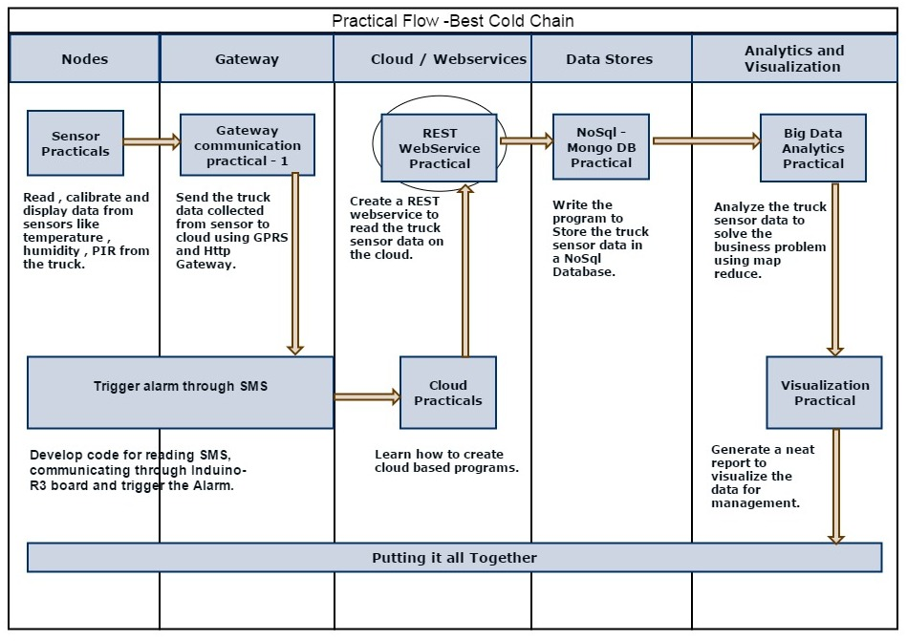
End to End Flow Diagram

Slide 3
REST (REpresentational State Transfer)
REST is a Resource Oriented web services (Architecture)
Alternate to using complex mechanisms such as CORBA, RPC or SOAP to connect between machines
REST uses HTTP for all four CRUD (Create/Read/Update/Delete) operations, it runs on top of HTTP.
Platform-independent (you don't care if the server is Unix, the client is a Mac, or anything else)
Language independent
Very easy to implement and very simple

Slide 4
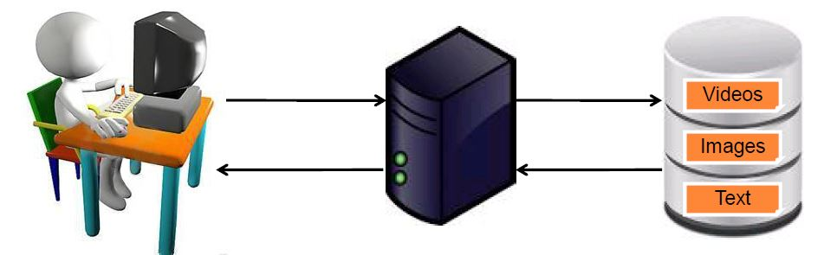
Resource Oriented web services
Every distinguishable entity is a resource
A resource may be a HTML page, XML document, a Image, a video etc..
Every resource is identified by the uniquely URI
Resource life cycle management using HTTP methods
CRUD | HTTP METHOD used by REST
Create | PUT or POST
Read | GET
Update | PUT or POST
Delete | Delete

Slide 5
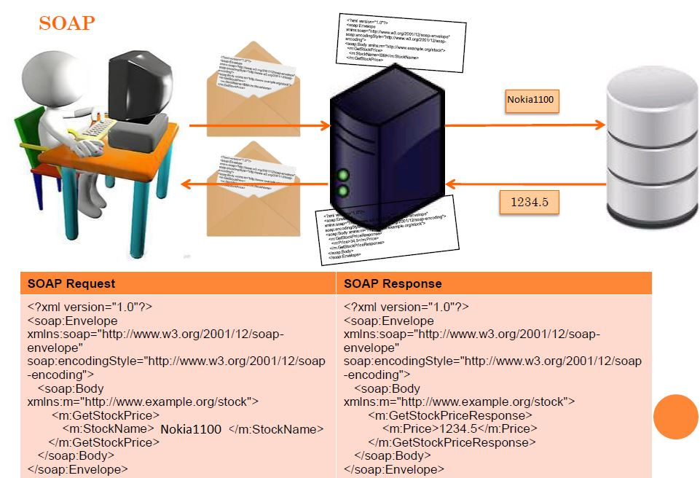
How simple is REST ?

Slide 6
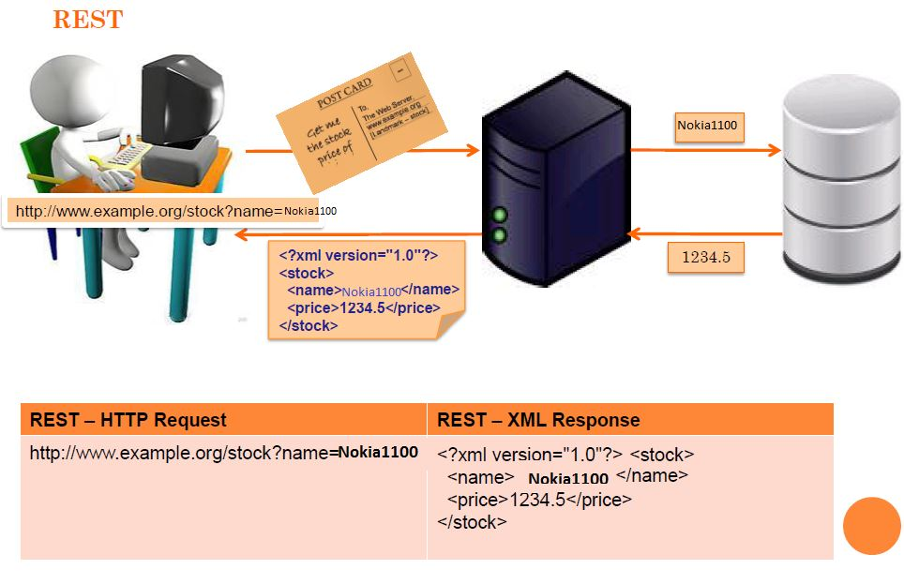
REST – XML as Message Protocol

Slide 7
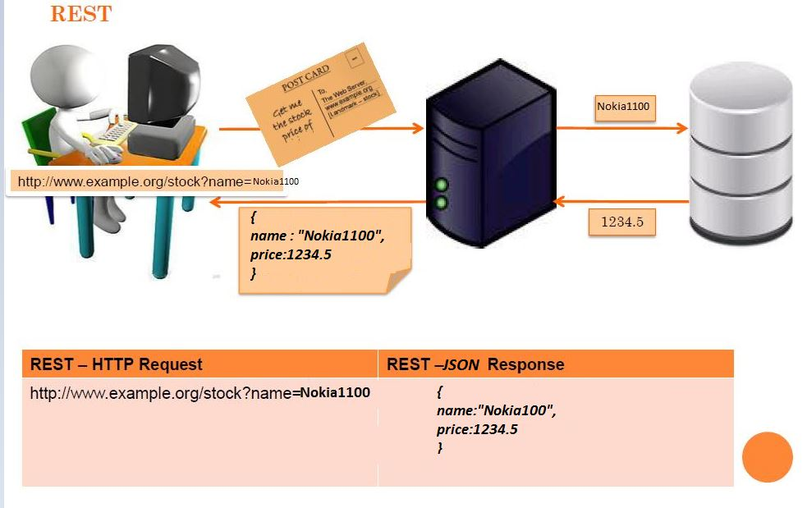
REST – JSON as Message Protocol

Slide 8
JAX-RS Implementations
Jersey
Restlet
Apache CXF
JBoss RESTeasy
Apache wink

Slide 9
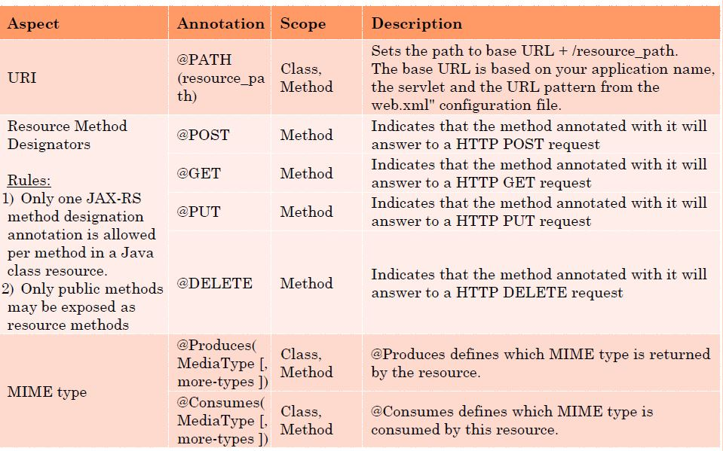
Important JAX-RS Annotations

Slide 10
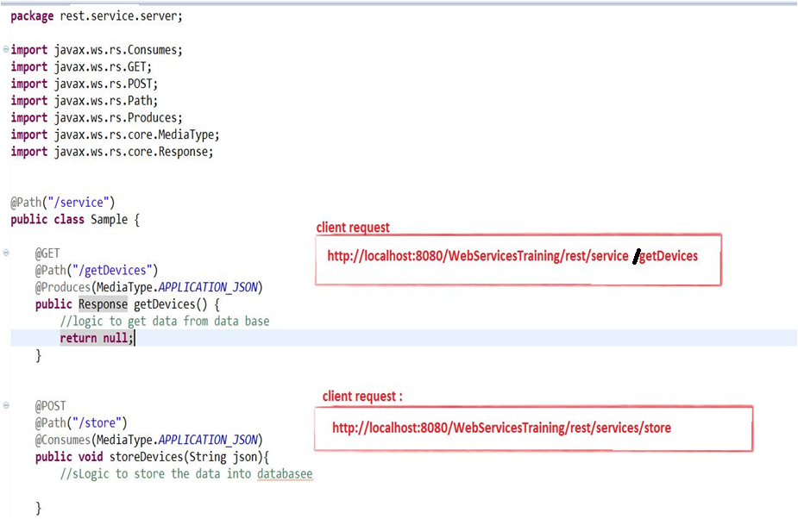

Slide 11
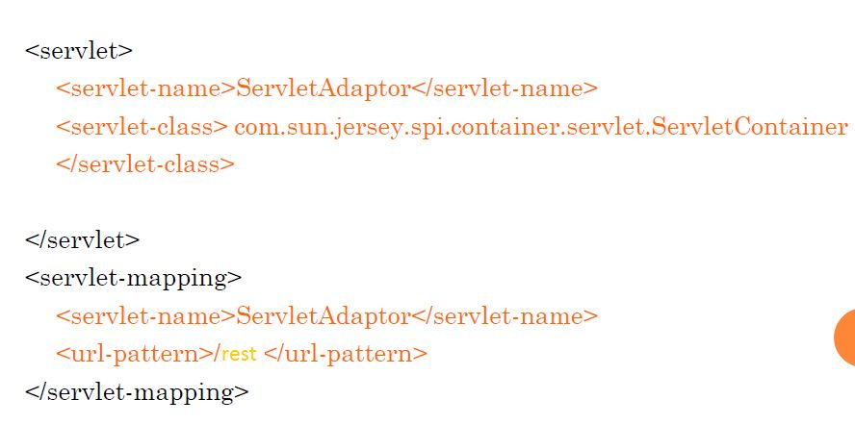
Configuring Jersey – web.xml

Slide 12
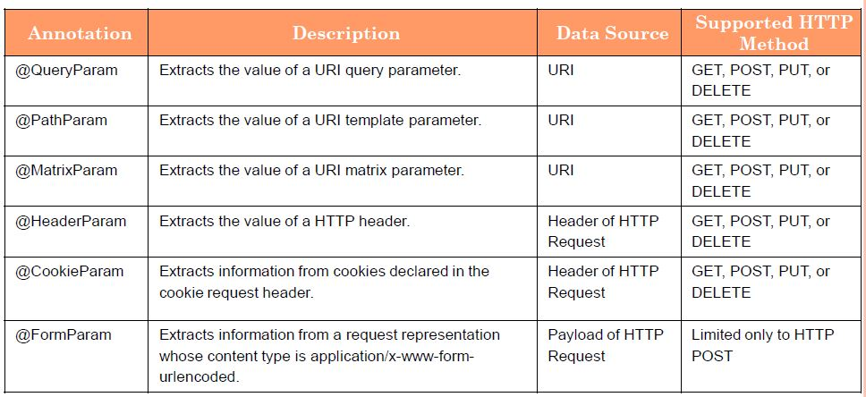
Extracting Request Parameters

Slide 13
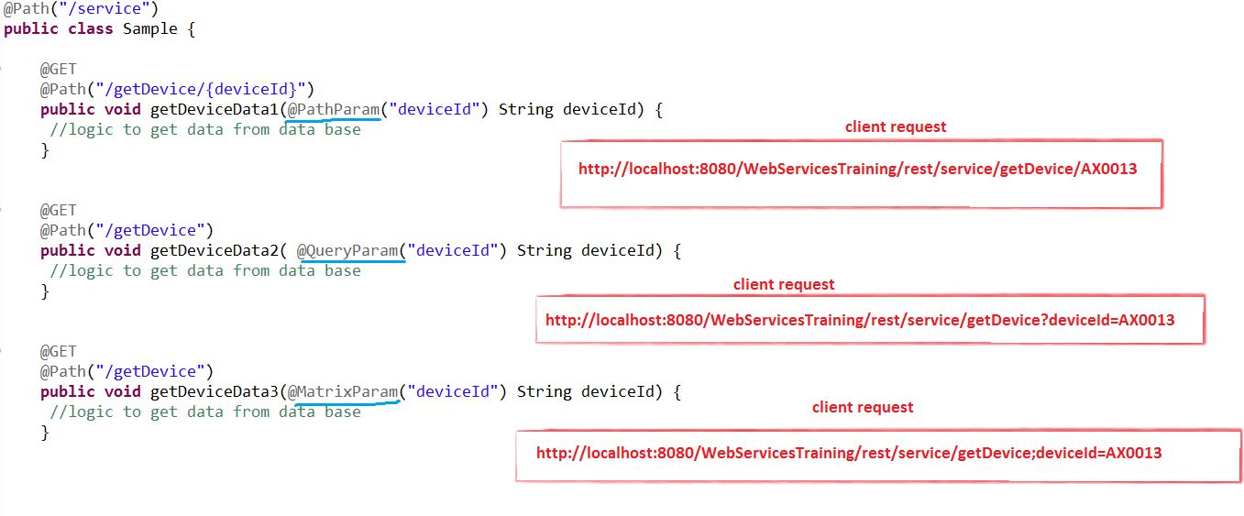

Slide 14
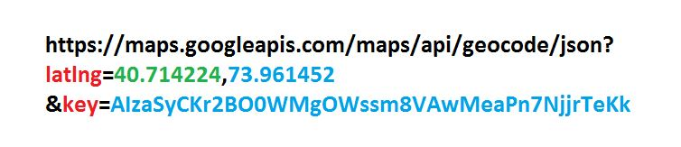
Google REST API to Find the Location
Service Consumer Request (Client) :

Slide 15
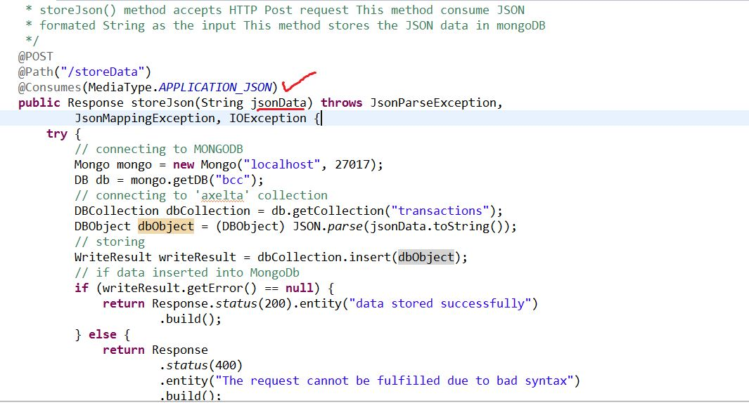
POST Practical

Slide 16
Advanced REST Client :
Using Advanced REST Client app from the chrome web store to call server side web service by passing the JSON Object.
It is a client to call the web service

Slide 17
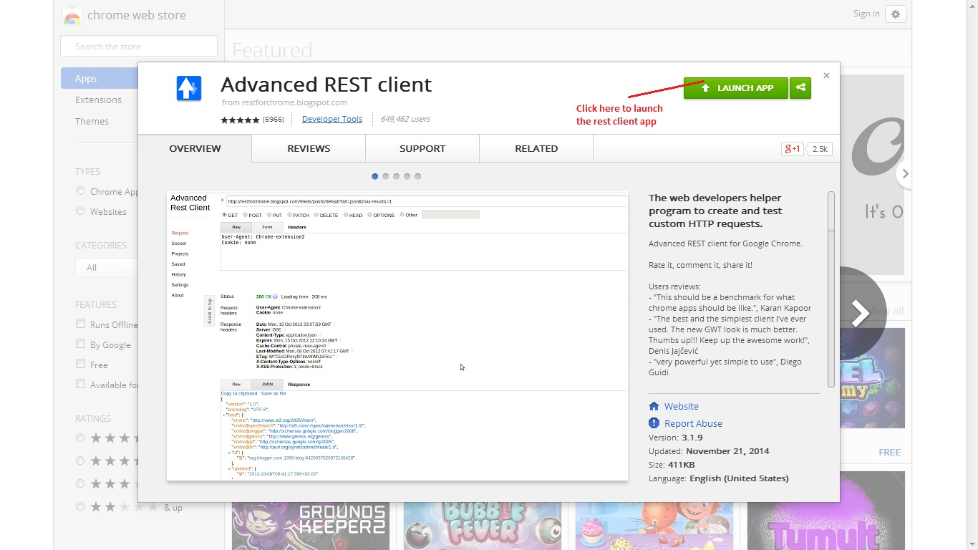
Advanced REST Client

Slide 18
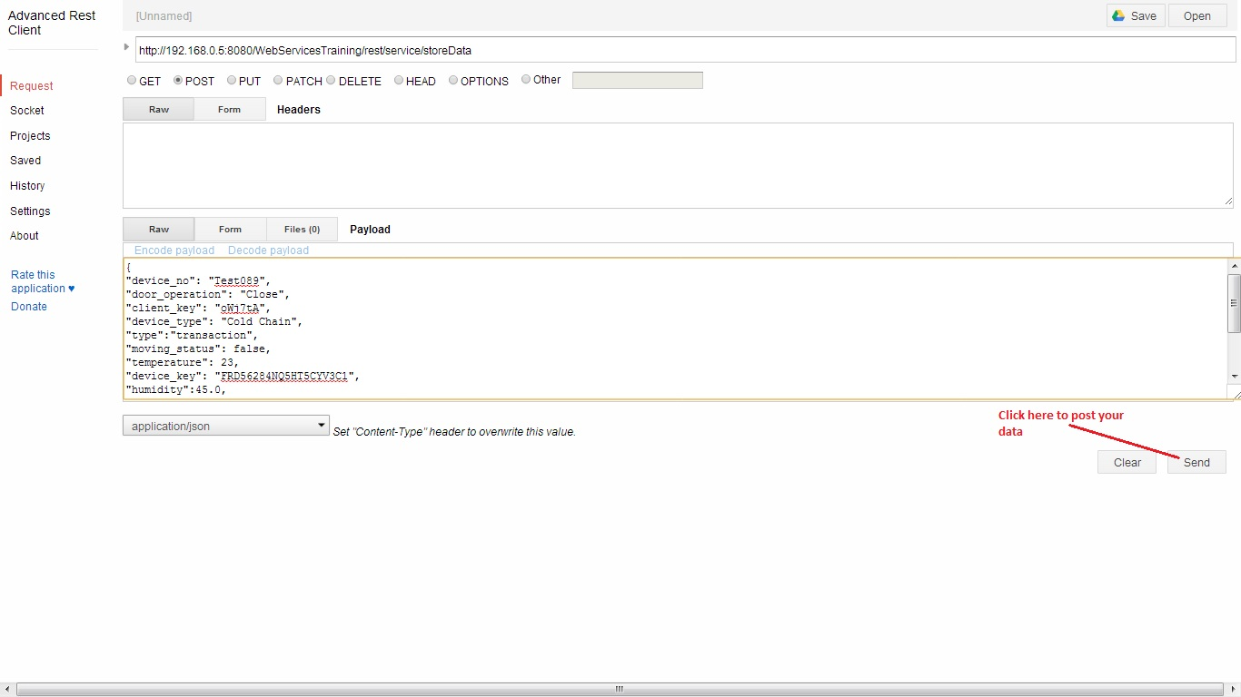
Posting the data

Slide 19
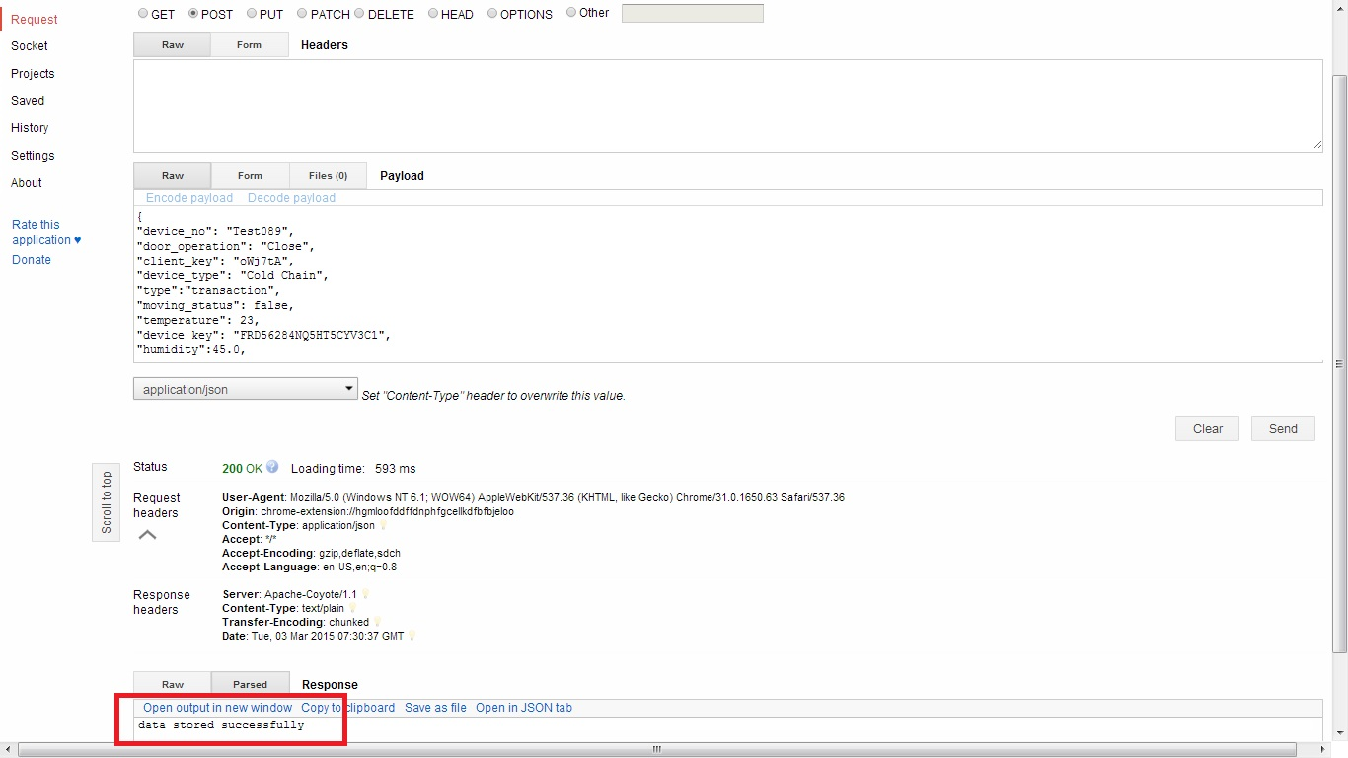
Response from the REST Client

Slide 20
Thank you

